Slide 1
File Handling
Session 14

Slide 2
Agenda
Working with files and directories
Hard Links and Soft links
Pipes and Fifo Implementation

Slide 3
Hard disk
Formatting (initial)
Creating partitions
Why partitions ?
File system on each partition

Slide 4
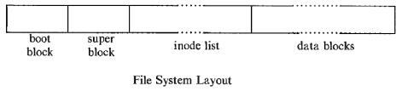
Partitions and Filesystem
When filesystem is created partition will have 4 blocks
Boot Block
Superblock
Inode blocks
Data blocks

Slide 5
Contents of I-Node
File type
Number of links (the number of aliases file has)
Owner(the user-id number of the owner)
Group (the group-id number)
File Mode (the triad of the three permissions )
Number of bytes in the file (file size)
Date and time of last modification
Date and time of last access
Date and time of last change in the inode
An array of 13 pointers to the file
Interesting no inode number and name of file . This info is stored in directory of the file

Slide 6
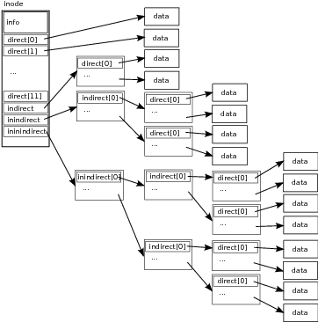
Data blocks
used for storing data
Block addressing scheme

Slide 7
Boot block and Superblock
Boot block
used if partition is of bootable type and if used, then stores kernel image
Superblock
The size of the file system
The length of the disk block
Last time of updation
The number of free data blocks
A partial list of immediately allocable free data blocks
Number of free inodes available
A partial list of immediately usable inodes

Slide 8
Directory
Opening directory
DIR *opendir(const char *name);
DIR *fdopendir(int fd);
DIR - directory stream, fd - file descriptor, name - dir file along with path
opendir opens directory and position DIR stream at first dir entry
fdopendir opens DIR stream from the given fd which refers to already
open directory using functions which returns fd.
Directory entry
struct dirent {
ino_t d_ino; // Inode number
char d_name[]; // file or dir name
}

Slide 9
Directory
Reading directory
struct dirent *readdir(DIR *dirp);
- read directory entry (dirent) from directory stream pointed by dirp
- returns pointer to directory entry on success
- NULL when reached at the end and errno is not set
- in case of failure NULL is returned and errno is set
Closing directory
int closedir(DIR *direp);
-- closes directory stream pointed by direp and returns 0 on success and -1 on failure

Slide 10
How the kernel accesses file
Kernel always maintains inode of the current directory in memory
Using this inode, searches inode blocks and locates the disk block of directory
fetches disk block of directory
In directory disk block searches the file name and finds the inode number of file
From inode number of file, searches the inode blocks and finds the size and disk block where data file is located
Read number of bytes from disk block equal to the size of the file found in inode of the file

Slide 11
hard links and soft links
hard link
ln <hardlink file> <original file>
Actual data will be allocated in disk block
inode of hardlink file and original file will be same
kernel increments link count after creation of a hard link
if a particular hard link is deleted then kernel decrements link count by 1
link count zero means data file can be erased
not possible to create hard link between files on different file system
can’t link a directory from within the file system
Soft Links (symbolic link)
ln -s <sym link file> <original file>
Inode of both files will be different and disk block is not allocated for sym link file
don’t have limitations of hard link
Only link will be created for sym link file
removal of link don’t have any effect

Slide 12
Low level functions for opening, reading, writing and closing
Low level functions work on file descriptors whereas high level functions
fopen, fread, fwrite, fprintf, fscanf work on streams
Opening file
int open(const char *pathname, int flags);
int open(const char *pathname, int flags, mode_t mode);
int creat(const char *pathname, mode_t mode);
pathname - file along with path
flags - way of access (read O_RDONLY, write O_WRONLY, both O_RDWR, creation
O_CREAT etc. )
mode - Permissions (user, group and others)
return type - fd
Writing to a file
ssize_t write(int fd, const void *buf, size_t count);
fd - file descriptor returned by open or other similar functions
Buffer - data to be written
count - size of data to be written
return value - number of bytes written in case of success or sometimes 0, -1 if fails

Slide 13
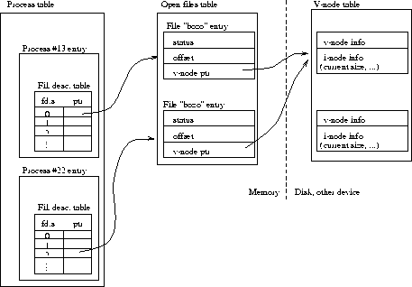
file descriptor table

Slide 14
Low level I/O functions
Reading from file
ssize_t read(int fd, void *buf, size_t count);
fd - file descriptor returned by open or other similar functions
Buffer - location to store read data
count - size of data to be read return value - number of bytes successfully read
Closing
int close(int fd);
returns 0 on success and -1 on failure
Example

Slide 15
Pipes and Fifos
IPC tools
Provides two ends
writing end
reading end
differs in ways of creation
usage is same after creation (internally)

Slide 16
Pipes
Data structure for storing file descriptors
int fd[2];
Creating pipe
pipe(fd);
fd[0] -- used for read and fd[1] -- used for write
How to read
read(fd[0], &buff, sizeof(buff))
How to write
write(fd[1], &buff, sizeof(buff))
Closing
close(fd[0]); close(fd[1]);
Capacity of pipe

Slide 17
Pipes
Using pipes in single process is of no use
Usual usage
As a communication link between parent and child
As a communication between siblings (two childs)
If used as communication link between parent and child, parent should close one end(read/write) and child should close the other end(read/write)
If used as communication link between childs then parent should close both ends

Slide 18
Example

Slide 19
Fifo
Named pipe (as internally kernel provides pipe for each created FIFO)
used for communication between two processes
usually created by using one of the following function
int mknod(const char *pathname, mode_t mode, dev_t dev);
With mode as S_FIFO along with |red to other permissions
2. int mkfifo(const char *pathname, mode_t mode);
pathname refers to file on filesystem
mode for permissions
what is return type?

Slide 20
Using Fifo
Both mknod and mkfifo return fd(file descriptor)
Using returned fd
reader program/process
open(fd, O_RDONLY);
read(fd, &buff, sizeof(buff));
writer program
open(fd, O_WRONLY);
write(fd, &buff, sizeof(buff));

Slide 21
Example

